Slide 1
Engineering Drawing & Graphics
Engineering Drawing & CAD
Lecture 4 (continued)
Projection of lines inclined to both planes
by
Umer Farooq
March, 2019

Slide 2
TRUE LENGTH (T.L.) AND TRUE INCLINATION (T.I.)
True inclination with the H.P. θ can only be seen in the F.V.
The length of T.V. is dependent on θ. T.V. and θ are inversely proportional.
The position of T.V. is a function of the True Inclination with the V.P., i.e., Φ.
If the F.V. of the line is T.L., then it must appear at an angle of θ with the xy line. The very moment ones sees a shorter length in the F.V., the apparent angle shall be larger than θ.
The apparent angle of the line with the H.P. is α.

Slide 3
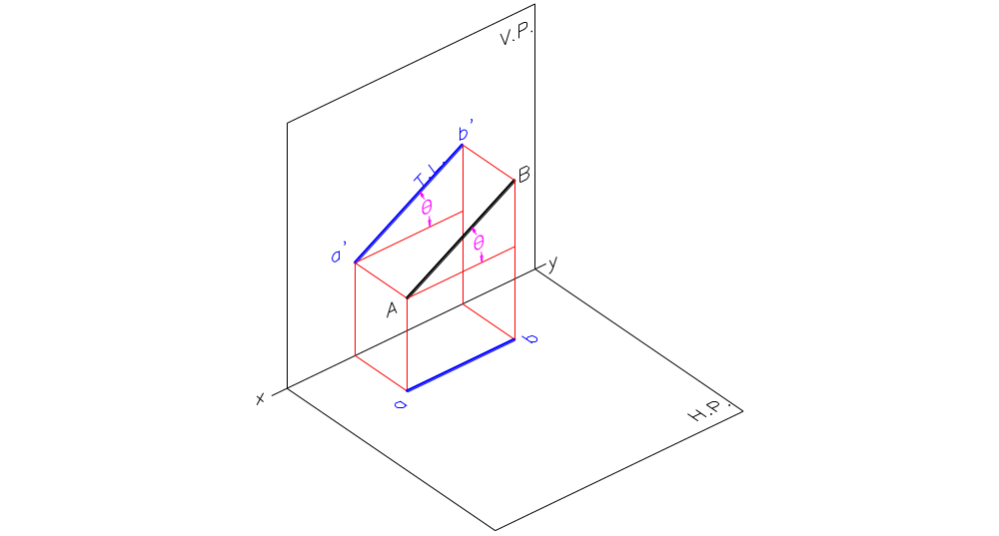

Slide 4
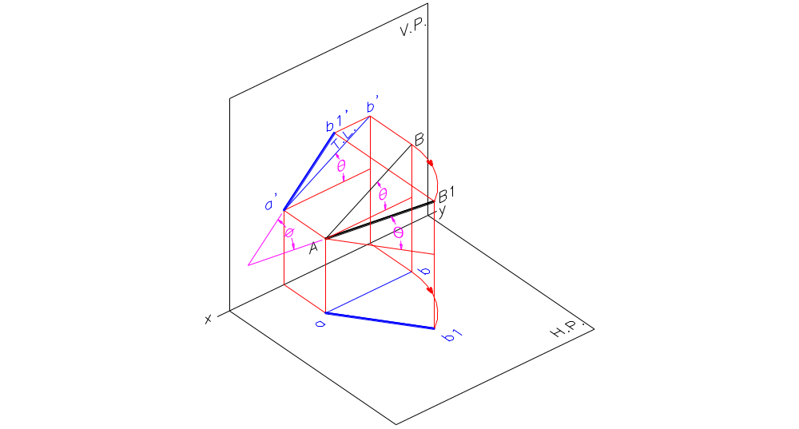

Slide 5
True inclination with the V.P. Φ can only be seen in the T.V.
The length of F.V. is dependent on Φ. F.V. and Φ are inversely proportional.
The position of F.V. is a function of the True Inclination with the H.P., i.e., θ.
If the T.V. of the line is T.L., then it must appear at an angle of Φ with the xy line. The very moment one sees a shorter length in the T.V., the apparent angle shall be larger than Φ.
The apparent angle of the line with the V.P. is β.

Slide 6
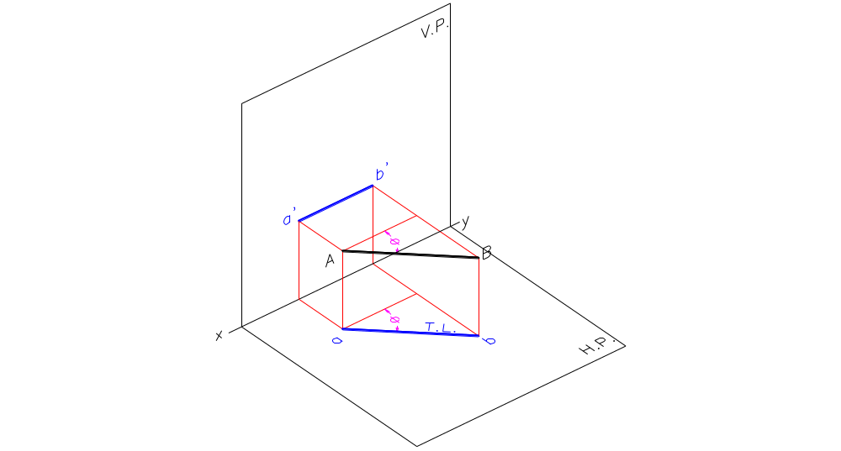

Slide 7
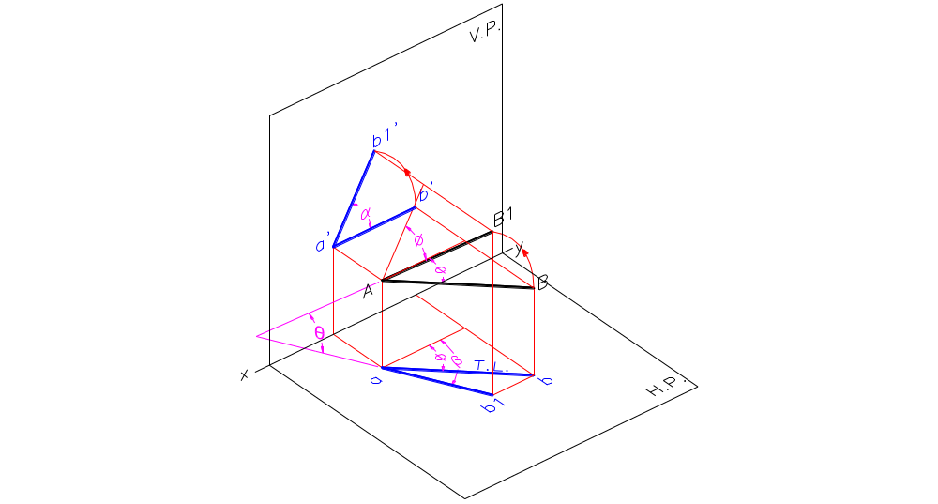

Slide 8
REQUIREMENTS TO DRAW THE PROJECTIONS OF A LINE AB INCLINED TO BOTH PLANES
FRONT VIEW
Distance of F.V. of end A from xy line
Distance of F.V. of end B from xy line
Length of F.V.
Angle of F.V. with the xy line, i.e., α
TOP VIEW
Distance of T.V. of end A from xy line
Distance of T.V. of end B from xy line
Length of T.V.
Angle of T.V. with the xy line, i.e., β

Slide 9
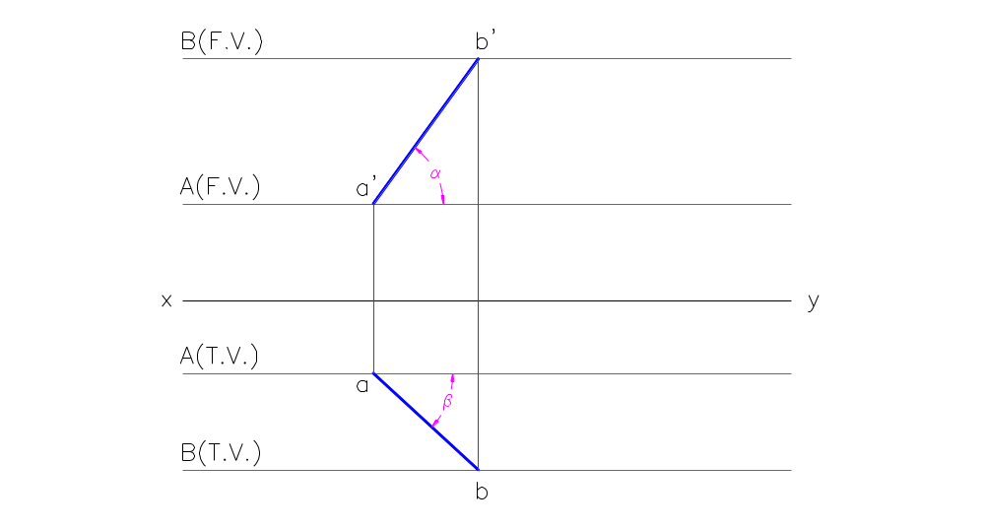

Slide 10
LINE INCLINED TO BOTH THE PLANES
Example:
A line AB 80 mm long has its end A 30 mm above the H.P. and 20 mm in front of the V.P. The line is inclined at 30º to the H.P. and at 45º to the V.P. Draw its projections.
Given:
AB = 80 mm = T.L.
End A is 30 mm above H.P.
and 20 mm in front of V.P.
True Inclination with H.P. = θ = 30º
True Inclination with V.P. = Φ = 45º

Slide 11


Slide 12
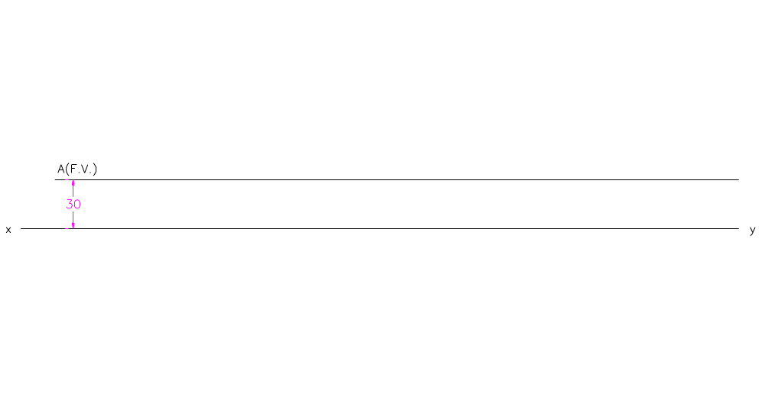

Slide 13
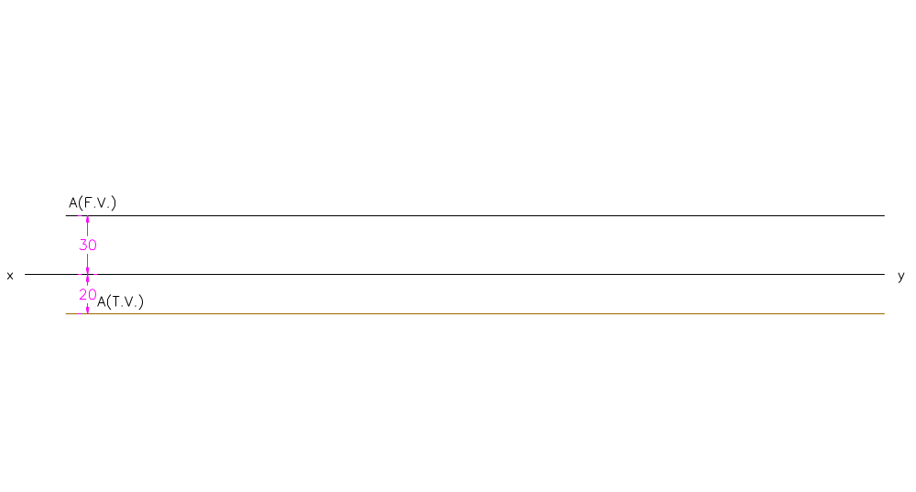

Slide 14
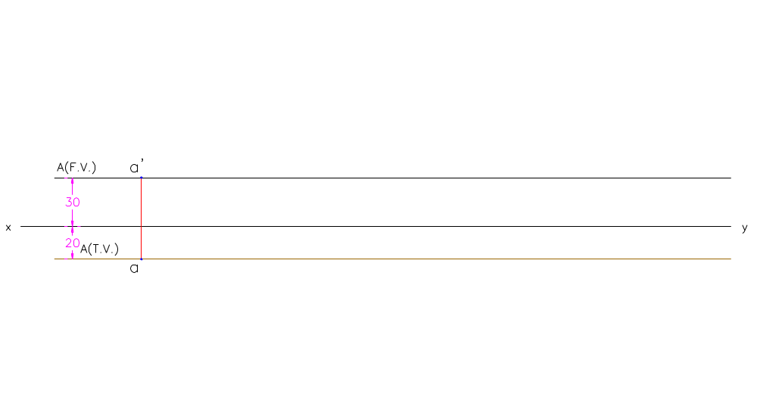

Slide 15
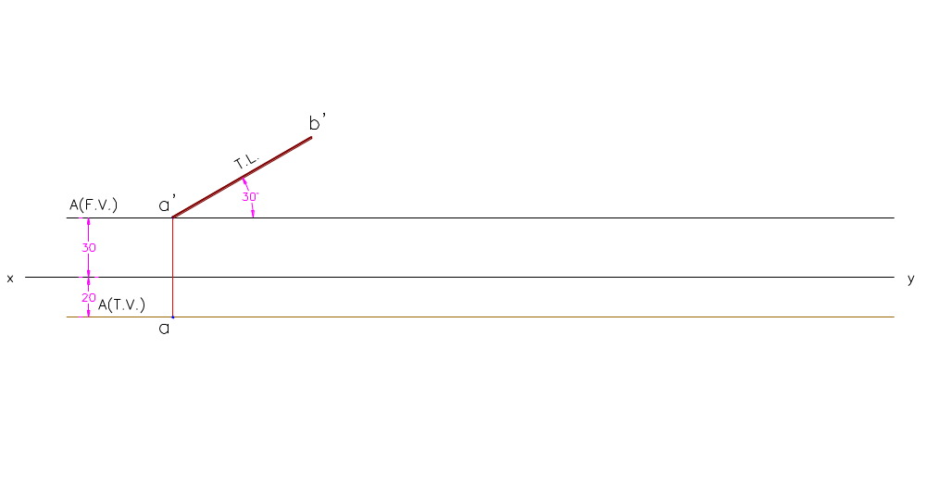

Slide 16
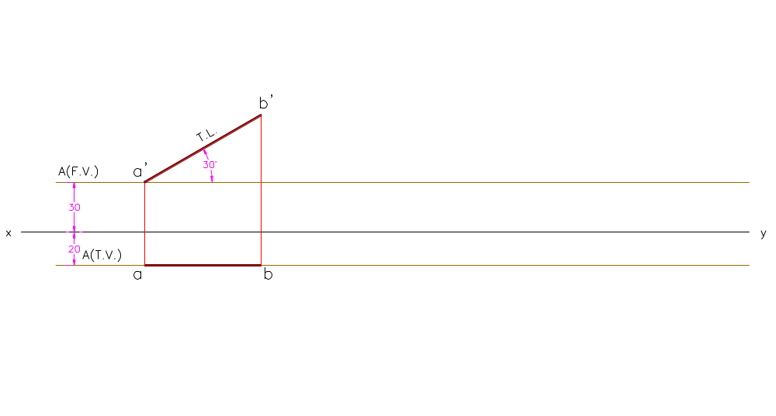

Slide 17
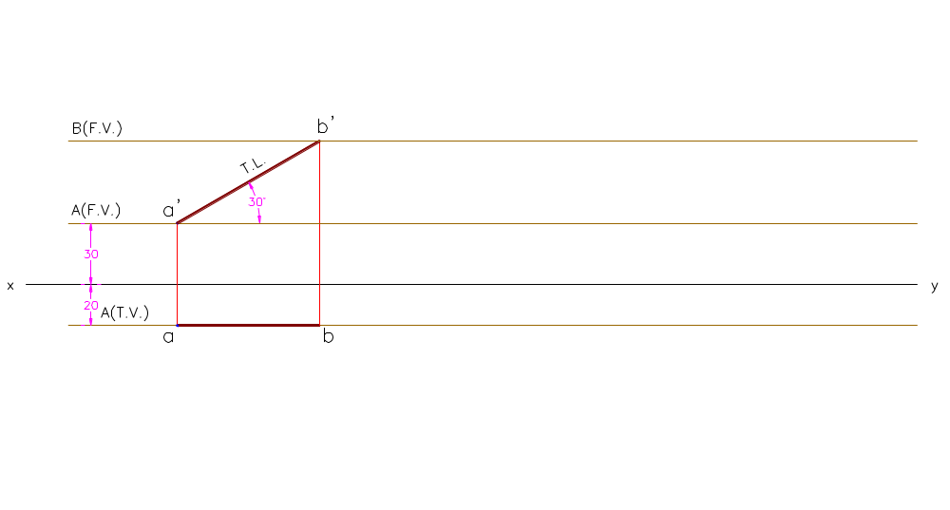

Slide 18
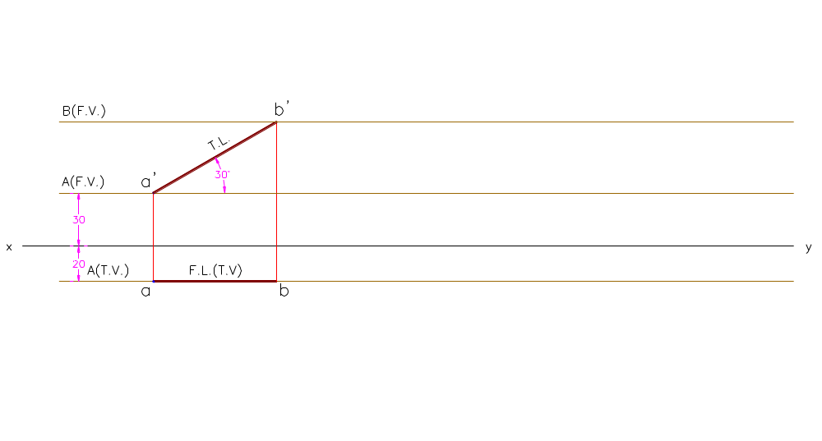

Slide 19
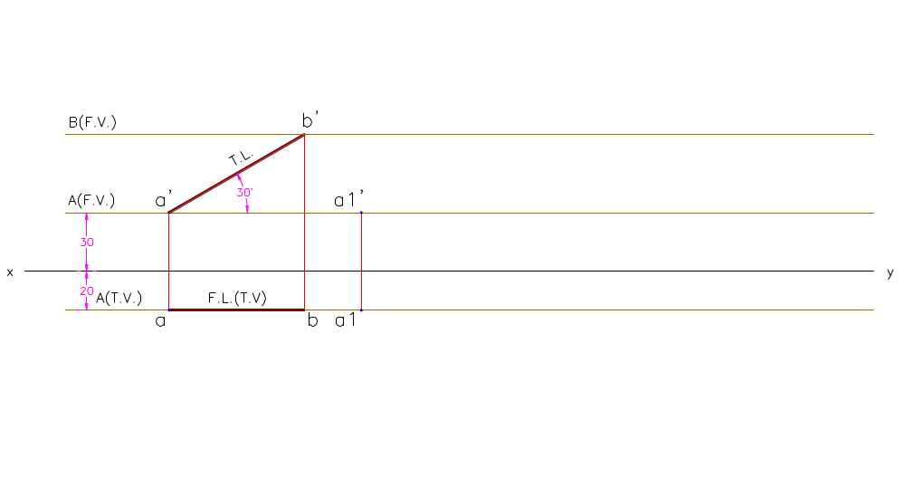

Slide 20
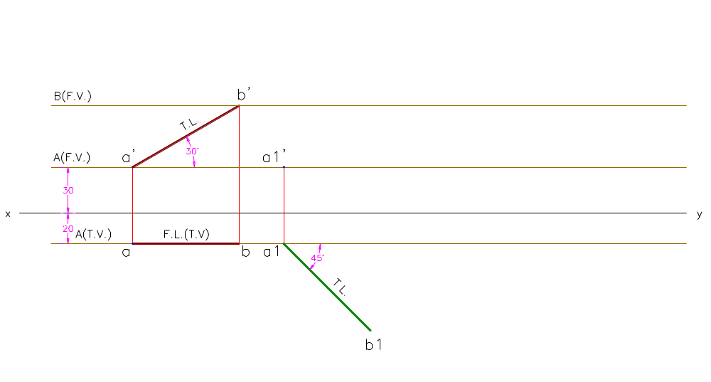

Slide 21
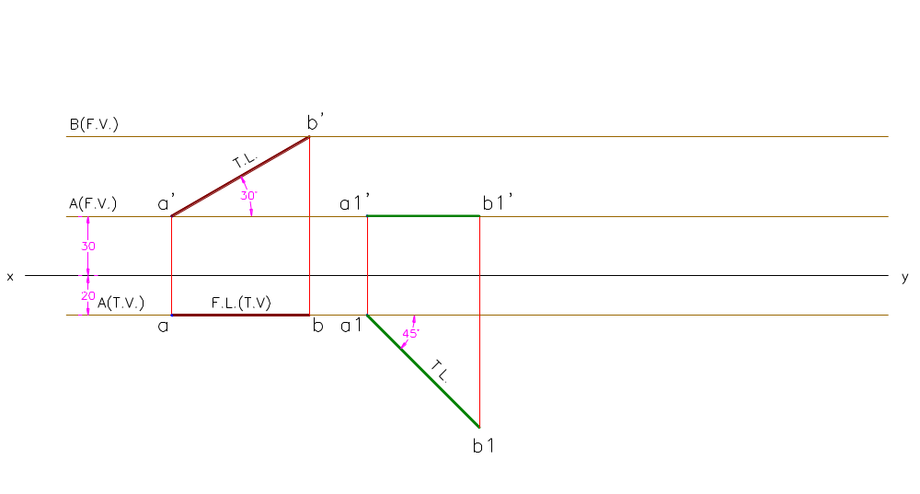

Slide 22
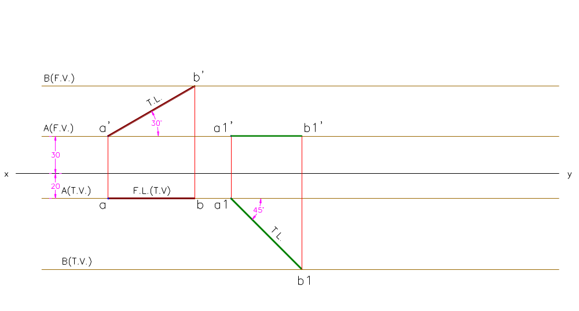

Slide 23
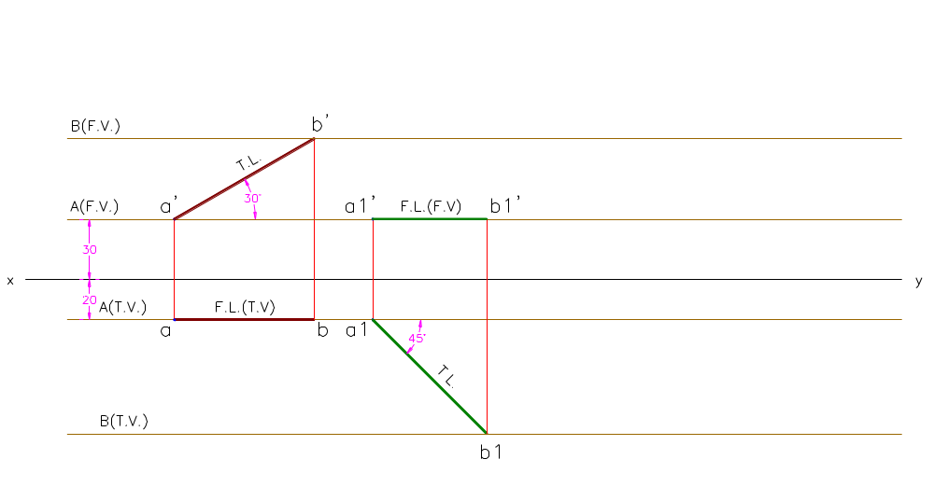

Slide 24
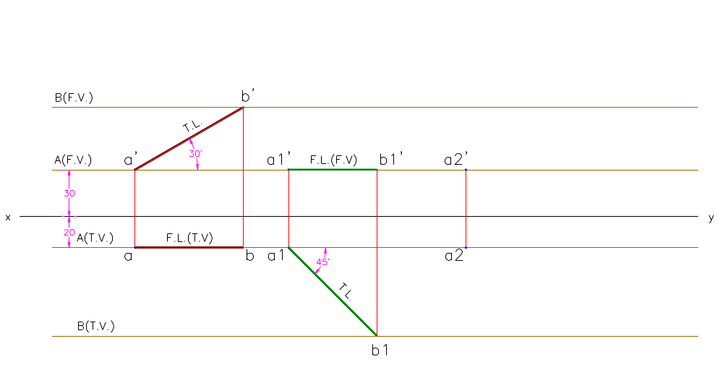

Slide 25
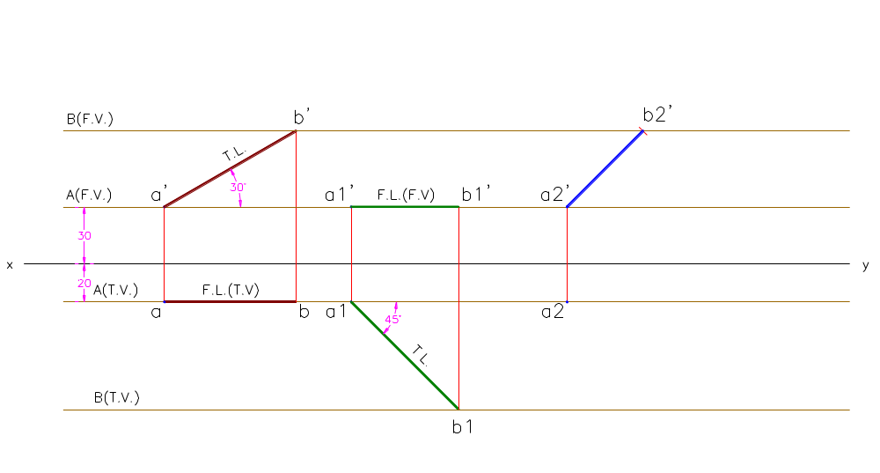

Slide 26
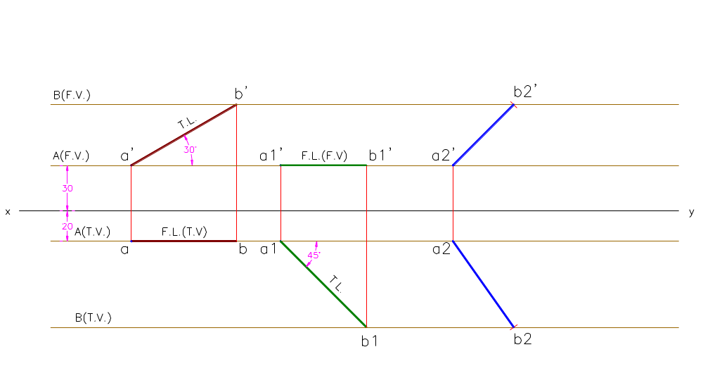

Slide 27
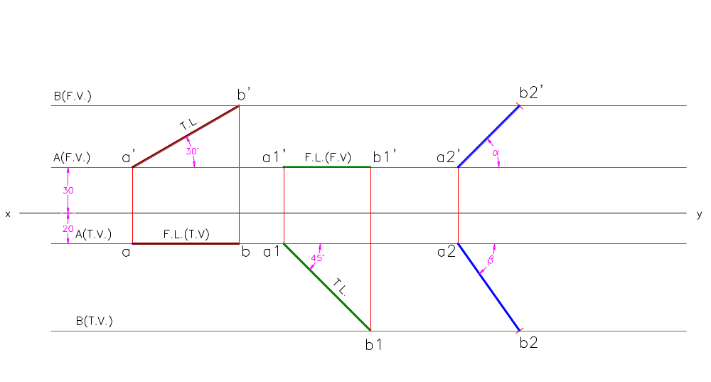

Slide 28
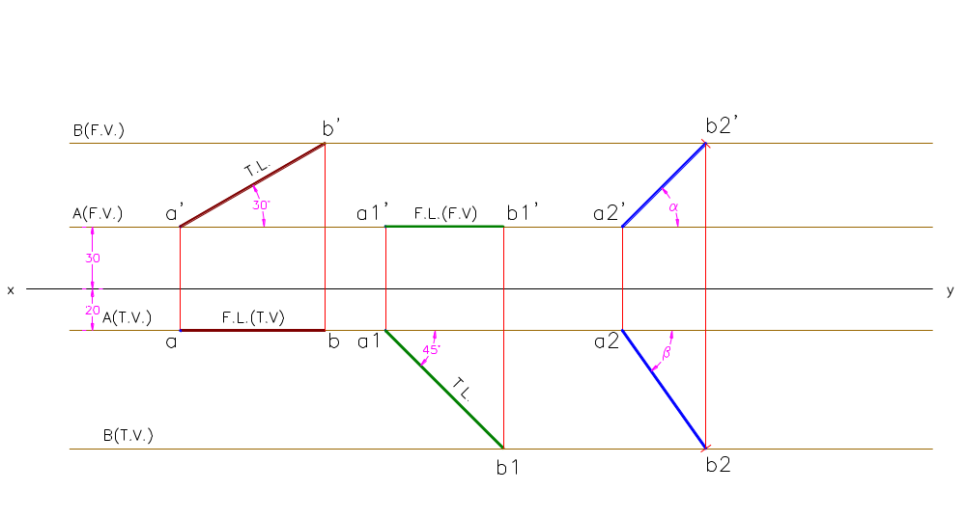

Slide 29
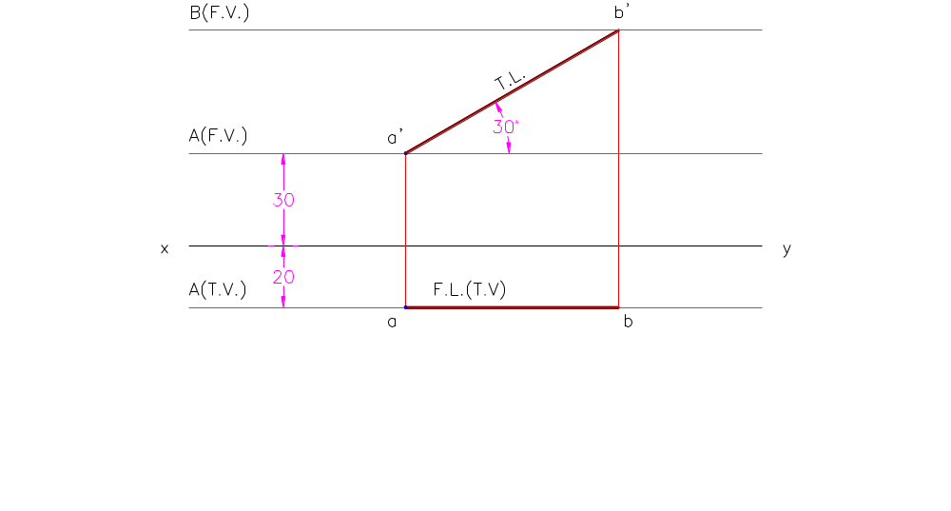

Slide 30
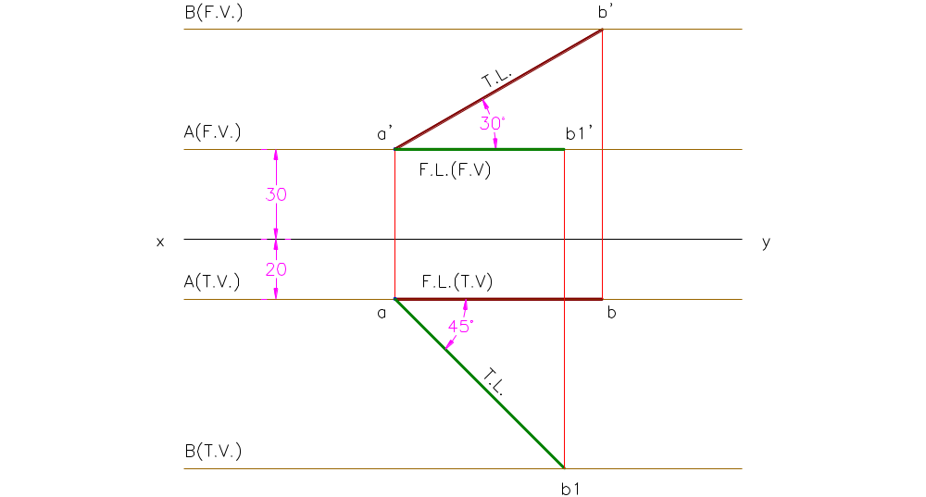

Slide 31
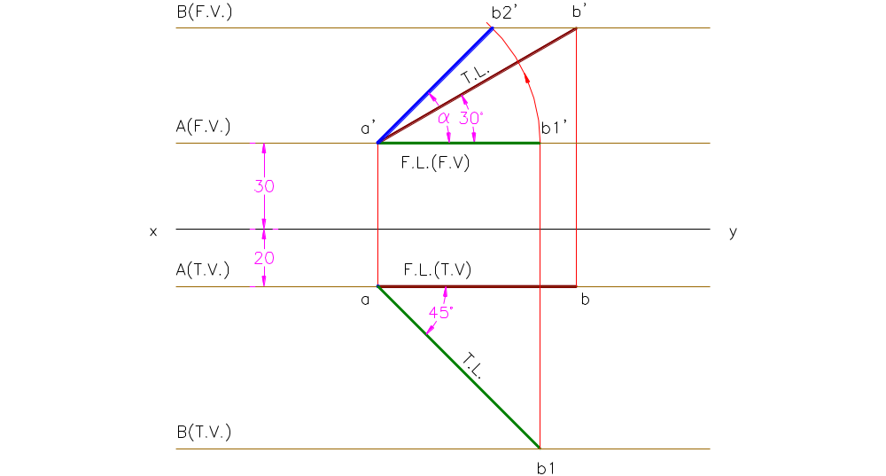

Slide 32
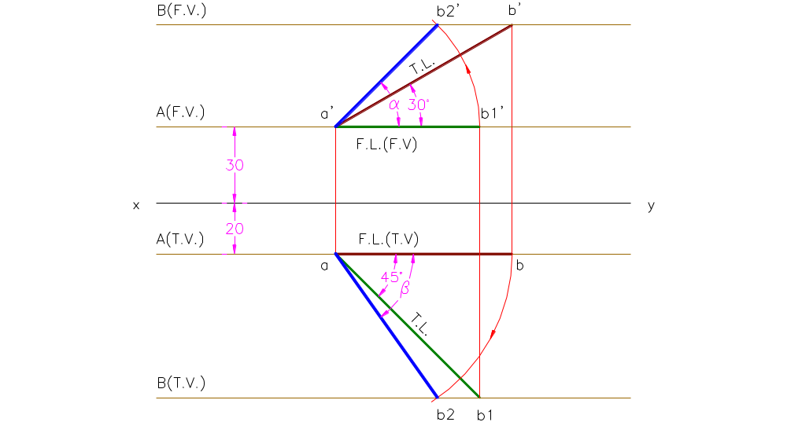

Slide 33


Slide 34
Example:
A line AB has its end A 30 mm above the H.P. and 20 mm in front of the V.P. The front view of the line 65 mm long and is inclined at 60º to the xy line whereas its top view is inclined at 45º to the xy line. Draw the projections of the line AB and find its true length. Also find its true inclinations with the H.P. and the V.P.
Given:
Line AB
End A is 30 mm above H.P.
and 20 mm in front of V.P.
Length of Front View = 65 mm
Angle of Front View = α = 60º
Angle of Top View = β = 45º

Slide 35
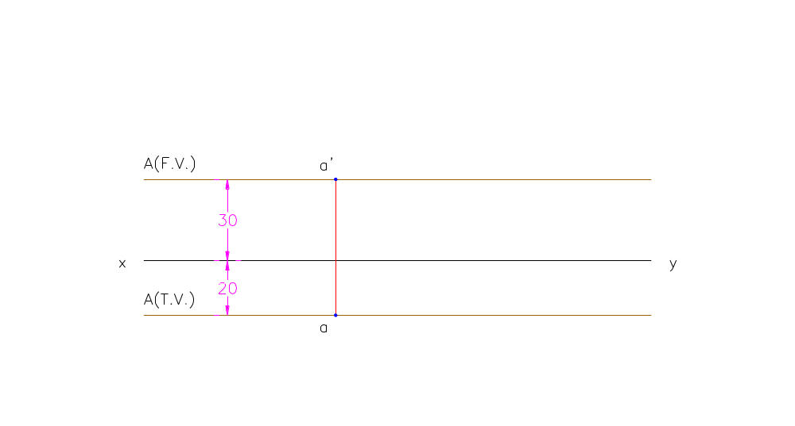

Slide 36
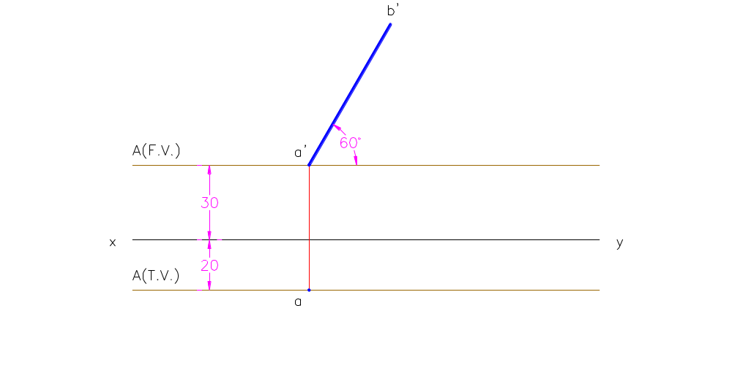

Slide 37
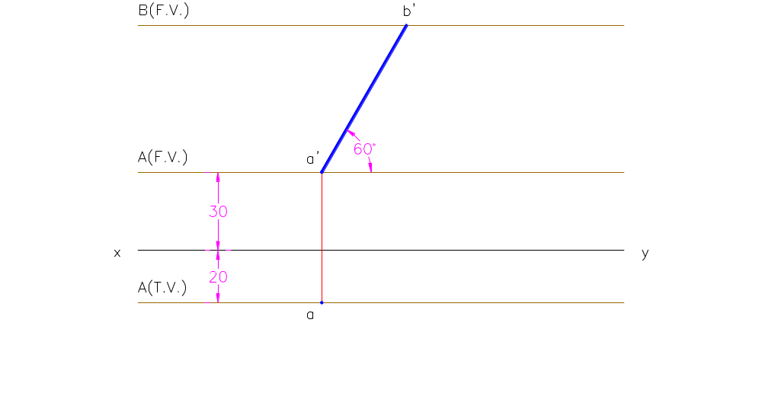

Slide 38
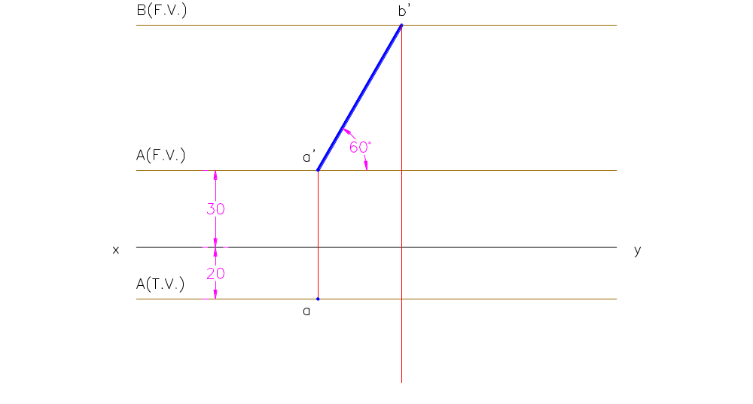

Slide 39
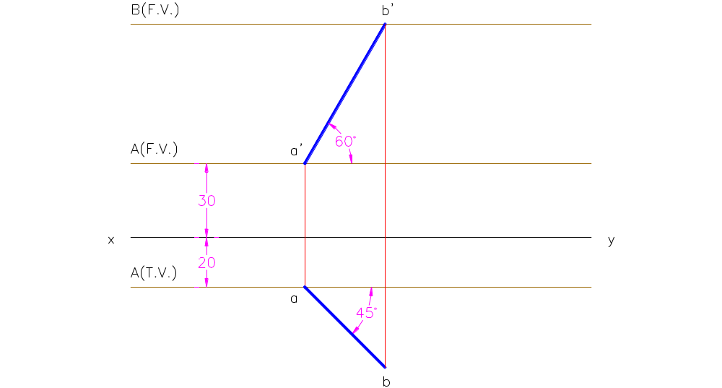

Slide 40
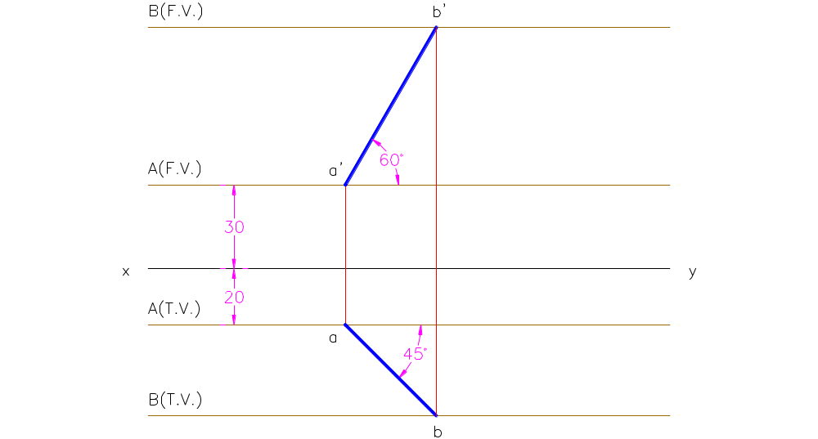

Slide 41
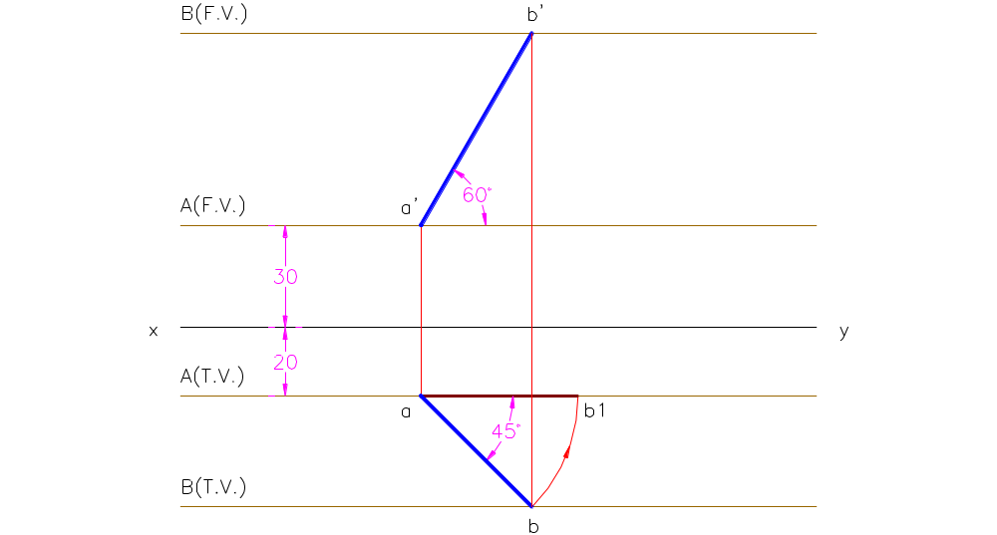

Slide 42
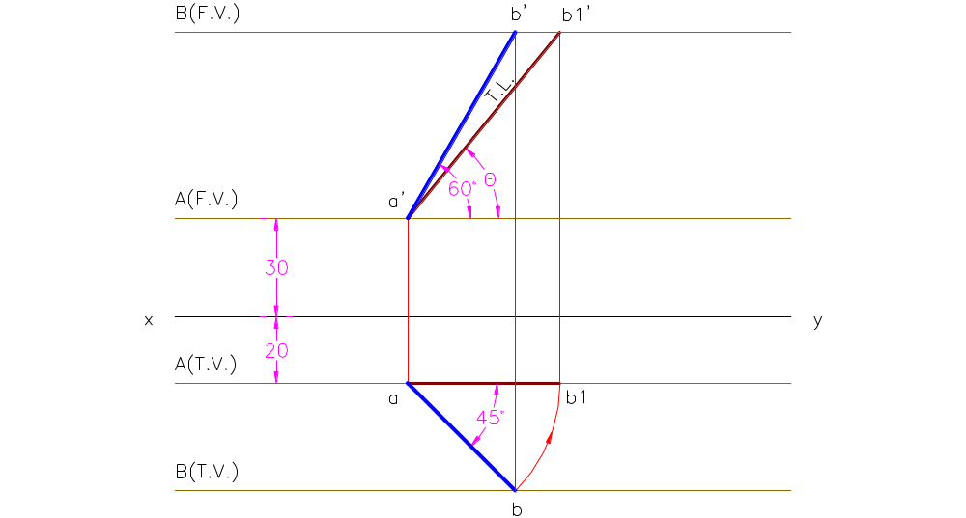

Slide 43
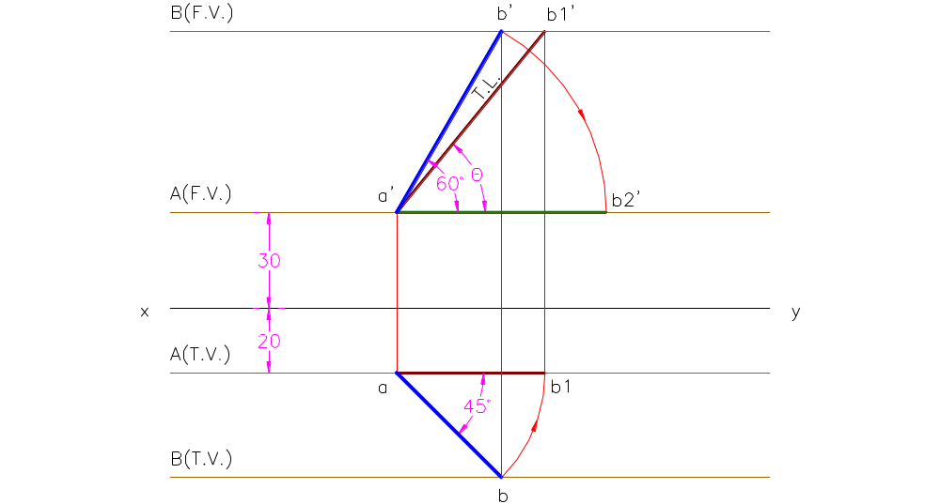

Slide 44
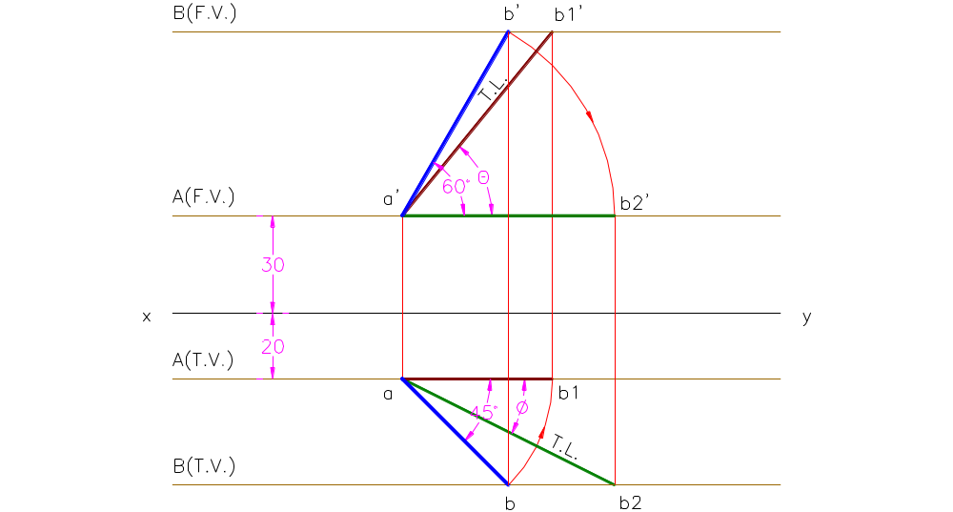

Slide 45
Assignment # 2
Page # 200 Chapter 10 N. D. Butt 52 Edition
Problems # 1 to 8 (even)
Page # 237 Chapter 10(b) N. D. Butt 52 Edition
Problems # 1 to 15 (every third question)
Exercise # 10(a)
Rest of the questions is for practice

Slide 46
Thank You

